Slide 1
Does a Couple’s Supportive Action Affect Patient’s Treatment on Diabetes?
Andersen Chang
Mengran He

Slide 2
Background
EDA
Modeling
Future Work
Questions

Slide 3
Type 2 Diabetes
Pervasive chronic disease
Associated with other negative health effects
Typically diagnosed in adulthood

Slide 4
Type 2 Diabetes
Treated through self-care habits: exercise, diet, medication.
Adherence/effectiveness
People don’t exist in a vacuum.
How does patient’s social environment affect treatment?

Slide 5
Communal Coping
Cooperative problem-solving process salient in dealing with both individual and collective stressors
Involves the appraisal of a stressor and collaboration to address the problem
In context: romantic partner’s contribution to patient treatment.

Slide 6
Objectives
Communal Coping in couples
Good psychological outcomes for both patients and partners
Good diabetes outcomes for the person with diabetes

Slide 7
Client Questions
Does communal coping and collaboration improve outcomes for diabetes patients? How much?
Are the expected outcomes different depending on race and gender?
Is there a combination of communal coping sentiments that works best?

Slide 8
Background
EDA
Modeling
Future Work
Questions

Slide 9
Data Collection on Daily Diaries
Recruited from local community
Years: 2012 - 2015
120 couples
1576 entries
~30 variables (ID, date, race, gender, emotions, mood and opinions about cooperative behavior)

Slide 10
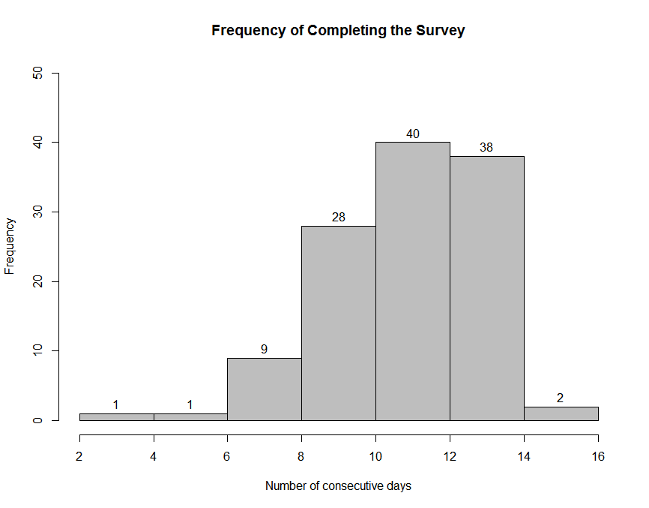
1343 complete cases (119 couples) out of 1576 recorded days.

Slide 11
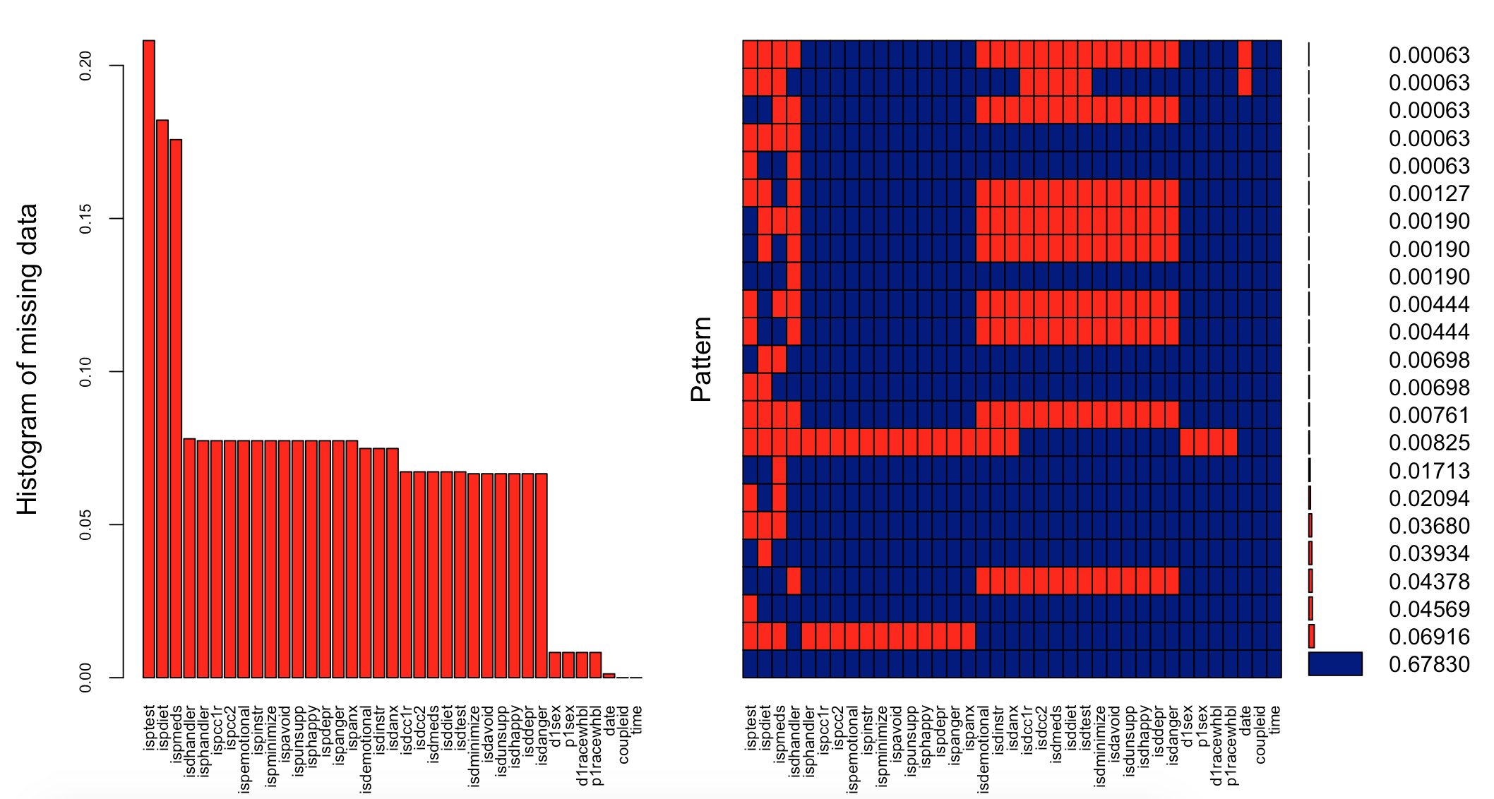
Notes:
Most common occurrence: one of patient or partner responded, but the other did not.
Currently only looking at days with complete data.

Slide 12
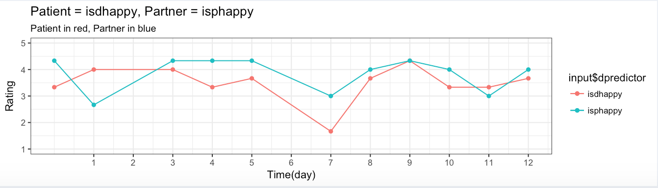
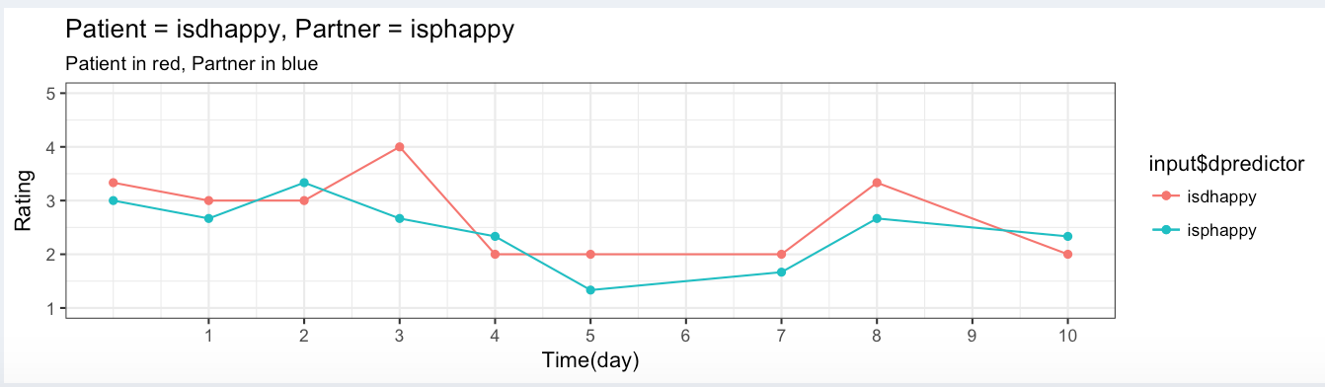

Slide 13
Background
EDA
Modeling
Future Work
Questions

Slide 14
Modeling Strategies
Factor Analysis
Mixed models

Slide 15
Factor Analysis - Definition
Explorative analysis → Investigate variable relationships
Factor: Captures a certain amount of the overall variance in the observed variables
Loadings: The relationship of each variable to the underlying factor (lurking variable)
Notes:
Factor Analysis is an explorative analysis, it can be used to investigate variable relationships for complex concepts such as socioeconomic status, dietary patterns, or psychological scales. Since factor analysis is an explorative analysis it does not distinguish between independent and dependent variables.
Each factor captures a certain amount of the overall variance in the observed variables
Factor Loadings: The relationship of each variable to the underlying factor, can be interpreted like standardized regression coefficients.

Slide 16
Factor Analysis - Psychological Behavior
Analyze couples’ perspectives about moods and support function on diabetes treatment
Mood: Happiness, Depression, Anxiety, Anger, etc.
Support Function: Emotional, Instrumental, Informational
Notes:
Emotional support: communication of caring and concern
Instrumental support: the provision of concrete assistance
Informational support: provision of information to guide or advise

Slide 17
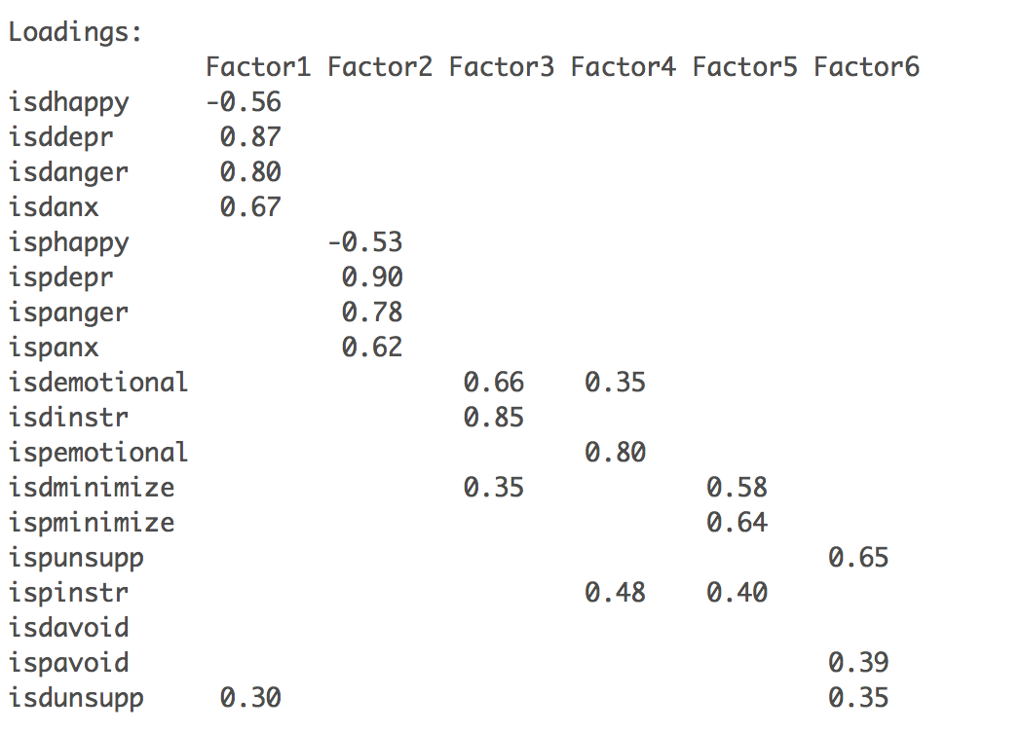
Factor Analysis - Results
Notes:
6 Factors explain 50% of the variance in the observed variables
Factor 1: patient’s answers about happiness, depression, anger, anxiety and opinion about support function have strong association to the underlying latent variable. Happiness has negative correlation with factor 1, while others have positive correlation with factor 1
Factor 2: similar to Factor 1, except these are answers from partners. Perspectives about support function don’t have much association in this factor category
Factor 3 and 4: couples’ opinions about emotional support have some association with opinion about instrumental support
Factor 5 and 6: opinions about unsupportive interaction between patients and partners are correlated

Slide 18
Mixture Model
Univariate models on mood/psychological outcomes
18 models!
Fixed effects: communal coping
View of diabetes?
How did you handle issues?
How much did you and your partner work together to take care of diabetes today?
Interactions with race and gender

Slide 19
Mixture Model
Random effects: patient/partner
Random intercept by couple
Time as random slope with respect to couple
Add AR(1) covariance between repeated observations
SAS...

Slide 20
Background
EDA
Modeling
Future Work
Questions

Slide 21
Things to Do...
Find best mixture model for all response variables.
Comparing BIC
Automatic model selection
Multivariate mixture models
Getting answers for our client

Slide 22
Background
EDA
Modeling
Future Work
Questions?

